Slide 1
Module 1V:
Traffic Safety and Environment:
Road accidents, Causes, effect, prevention, and cost, Street lighting, Traffic and environment hazards, Air and Noise Pollution, causes, abatement measures, Promotion and integration of public transportation, Promotion of non-motorized transport.

Slide 2
Accident studies
Objectives of accident studies:
Some objectives of accident studies are listed below:
To study the causes of accidents and suggest corrective measures at potential location
To evaluate existing design
To compute the financial losses incurred
To support the proposed design and provide economic justification to the improvement suggested by the traffic engineer
To carry out before and after studies and to demonstrate the improvement in the problem.

Slide 3
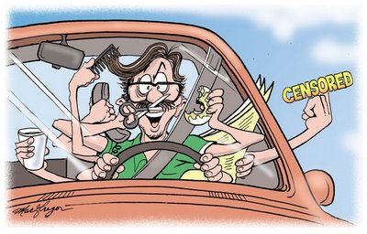
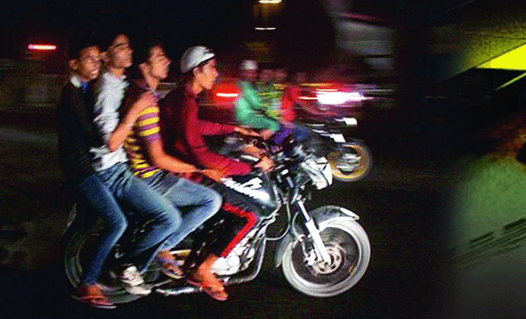
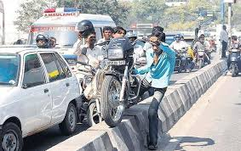
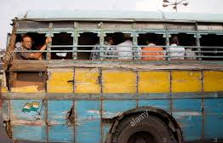
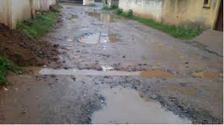
Causes of road accidents
The various causes of road accidents are:
1)Road Users -
Excessive speed and rash driving, violation of traffic rules, failure to perceive traffic situation or sign or signal in adequate time, carelessness, fatigue, alcohol, sleep etc.
  Pedestrians: Violating regulations, carelessness
2)Vehicle - Defects such as failure of brakes, steering system, tyre burst, lighting system
3)Road Condition - Skidding road surface, pot holes, ruts.

Slide 4
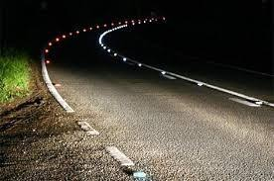
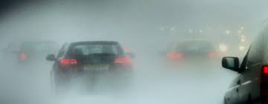
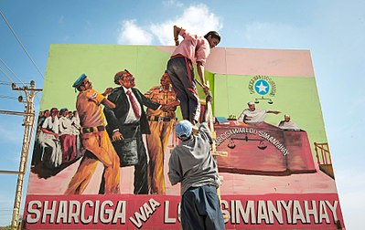
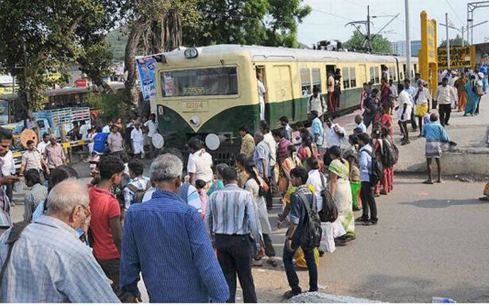
Causes of road accidents
The various causes of road accidents are:
4)Road design - Defective geometric design like inadequate sight distance, inadequate width of shoulders, improper curve design, improper traffic control devices and improper lighting
5)Environmental factors -unfavorable weather conditions like mist, snow, smoke and heavy rainfall which restrict normal visibility and makes driving unsafe.
6)Other causes -improper location of advertisement boards, gate of level crossing not closed, animal crossing
etc.

Slide 5
Effects and cost of accidents
The World Health Organization has estimated that road crashes caused in 2004, 1.27 million deaths and between 20 and 50 million people suffer non-fatal injuries .
Over 90% of the accident fatalities happen in low-income and middle income countries
9th leading cause of death
The cost of crashes in the world is estimated to be of 518 billion US dollars in the world
The burden on developing countries is of 65 billion dollars
Accidents are also a socio-economic issue
more than 50% of the rural households considered as poor after a crash leading to a death or serious injury

Slide 6
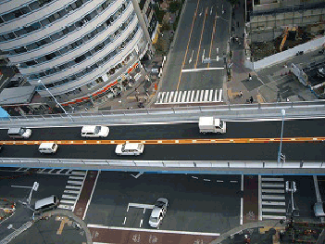
Accident studies Prevention
Measures for reduction of accidents
3 E’s
Safety measures related to engineering
Road designs:
Sight distances, width , horizontal and vertical alignment, intersection design elements
Pavement surface characteristics, skid resistance values
Necessary bypasses may be constructed
Grade separated intersections
Engineering
Enforcement
Education

Slide 7
Accident studies
Safety measures related to engineering
Preventive maintenance of vehicle
braking system, steering system, lighting system should be checked regularly
Heavy penalty on defective vehicles
Special checks on public carriers
Before and after study
By comparing the condition and collision diagnosis “before and after” the introduction of preventive measures
After necessary improvements in design and enforcing regulation
Road lighting
Proper road lighting especially at the intersections, bridge sites and at places where there are restriction in traffic movement

Slide 8
Accident studies
Safety measures related to enforcement
Speed control:
Checks on spot speed of all vehicles should be done at different locations and timings and legal actions on those who violate the speed limit should be taken
Training and supervision
The transport authorities should be strict while issuing licence to drivers of public service vehicles and taxis.
Driving licence of the driver may be renewed after specified period, only after conducting some tests to check whether the driver is fit
Medical check
The drivers should be tested for vision and reaction time at prescribed intervals of time

Slide 9
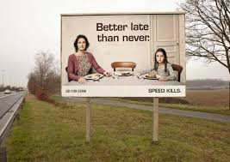
Accident studies
Safety Measures related to education
The various measures of education that may be useful to prevent accidents are enumerated below.
Education of road users : The passengers and pedestrians should be taught the rules of the road,
correct manner of crossing etc.
Introducing necessary instruction in the schools for the children and
Posters exhibiting the serious results due to carelessness of road users.
Safety drive: Documentaries and films for road users and drivers
Training courses and workshops
Imposing traffic safety weeks
Poster to create awareness on road safety

Slide 10
Traffic and environment hazards, Air and Noise Pollution, causes, abatement measures

Slide 11
Air pollution
Air pollution is defined as the excessive concentration of foreign matter in the air which adversely effect the well being of individual Or causes damage to the property
The fumes and smell emitted by other vehicles makes urban streets unpleasant.
The major pollutants are Oxide of nitrogen, oxide of sulphur, Carbon monoxide, Carbondioxide, particulate matter, water vapour, unburnt petrol, organic compounds produced from petrol,, lead compounds, carbon particles (smoke).

Slide 12
Pollutant | Source | Consequences
NO₂ | Vehicular exhaust | It forms smog and ozone, It causes respiratory illness, pulmonary disease, bronchitis etc
CO | Vehicle's exhaust as a result of incomplete combustion, Emissions from trucks, autos are significant | It interferes with the blood's ability to carry oxygen to the brain, heart, and other tissues. Unborn or newborn children and people with heart disease are in greatest danger from this pollutant, but even healthy people can experience headaches, fatigue and reduced reflexes and even death
SO₂ | Fuel containing sulfur is burned in diesel engines | Asthma, lung diseases, irritate mucus membrane, bronchitis, pulmonary diseases It can effect plants, animals and also properties
O₃ | Secondary formation from the vehicular exhaust gases such as reaction of NO₂ | It forms smog, ozone reacts with lung tissue. It can inflame and cause harmful changes in breathing passages, decrease the lungs' working ability, and cause coughing and chest pains.
Particulate matter (PM) | Particulate matter includes microscopic particles and tiny droplets of liquid/solids which comes from combustion of the fuel in vehicles | PM are very fine in size and they go deep into the lungs, where they may become trapped and cause irritation. Exposure to particulate matter can cause wheezing, asthma, respiratory illness, PM can serve as a vector for toxic air pollutants which may be carcinogenic
Lead | Lead can emitted from leaded petrol, However, usage of un leaded petrol resulted in significant drop in public exposure to outdoor lead pollution | Lead poisoning can reduce mental ability, damage blood, nerves, and organs, and raise blood pressure. Even small ingestions or inhalations of lead can be harmful because lead accumulates in the body
Hydrocarbons | Vehicular exhaust | Many hydrocarbons are carcinogenic

Slide 13
Air pollution
Abatement measures:
Improve vehicle design and maintenance.
Patronage of public transport system.
Use of alternative fuels and method of propulsion.
Restraining traffic through road pricing.
Stopping engines at the time of delays at intersections
Constructing bypasses and ring roads.
Staggering work hours
Institution of parking restraint.

Slide 14
Air pollution
Abatement measures: Following are the major control measures followed in India
Vehicular Emission Norms: Now we are in Bharat stage VI
2) Fuel Quality Specifications:
#Unleaded Gasoline
#Benzene Reduction
#Reduction of sulphur in diesels
3) Alternate Fuels
(i) CNG (Compressed Natural Gas)
(ii) LPG
(iii) Battery driven vehicles
4) Phase out of Grossly Polluting Vehicles
5) Improvement in lubricant oil quality
6) Adequate Traffic Management
7) Improvement in Public Transport System
8) Continuous research on technology improvement of vehicles
9) Mass awareness programs

Slide 15
Noise pollution
Noise is the unwanted sound. Noise in cities is the result of a number of activities such as road traffic, aircraft, railways and industrial and constructional works.
Generation of noise is by
    Various parts of the vehicle.
    Interaction between vehicle and road surface
    Noise dependent upon speed, flow and density of traffic.
Effect of noise:
This can be classified into three
Subjective effects: this include disturbance, noisiness etc and is difficult to be measured.
Behavioural effects: the noise can influence the behavior of people like sleeplessness, disturbance in studies, distraction in student’s mind etc.
Physiological effects: it can cause startle or fright phenomenon. Considerable exposure can even cause deafness

Slide 16
Noise pollution
Abatement measures:
Change in the design of vehicles- in India, Motor vehicles Act has made provisions to frame rules to control the noise produced by motor cycles.
Changes in tyre/ surface characteristics- smooth surfaces result in less noise.
Elimination of noisier vehicles- old vehicles produce more sound.
Modifications in traffic operations- rerouting commercial vehicles and buses from residential areas, providing by-pass to prevent high speed traffic from entering towns, ensure continuous and smooth and eliminate acceleration noise, prohibiting blow horns.
Designing streets, buildings and areas for producing less noise- narrow streets create noise conditions (canyon effect). Hence, streets should be wide to reduce noise pollution. Shrubs, trees and grass on the side of the road act as sound barriers.

Slide 17
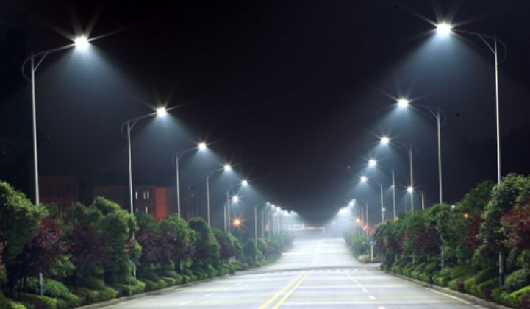
Road lighting

Slide 18
Road lighting
The level and type of lighting adopted for street lighting are based on its traffic importance, both vehicular and pedestrian.
Inadequately designed lighting installation may cause accidents which may be more grave than on normal roads.
The same quality of lighting shall be maintained, so that the drivers are given clear information with regard to their course and the presence and movement of other road users.
It is desirable to achieve a higher standard of lighting without causing glare

Slide 19
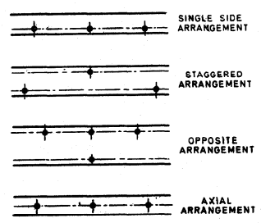
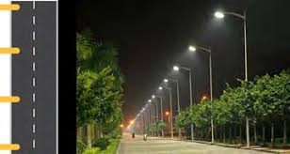
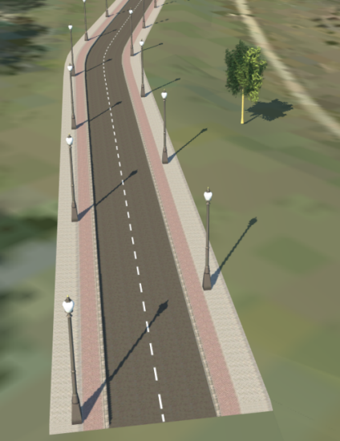
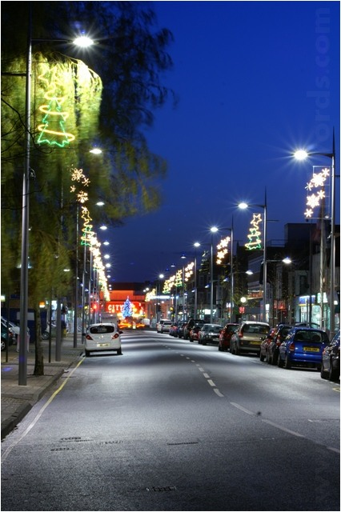
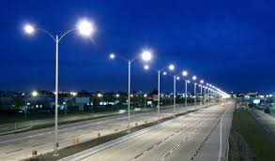
Road lighting
Basic arrangements of road lighting
Single side arrangement is suitable for narrow roads.
For wide roads, staggered, opposite or central lighting system can be provided.
Spacing is decided based on location, lamp size, mounting height and lighting requirements. Spacing range between 30-60 m.
At curves they are installed at closer spacing’s than on straights.
Single side
Staggered
Opposite
Axial

Slide 20
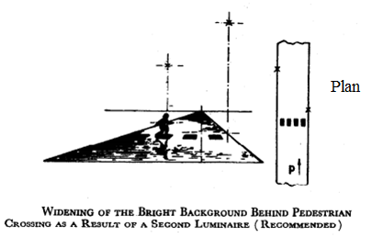
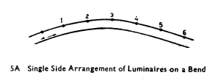
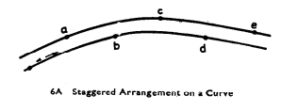
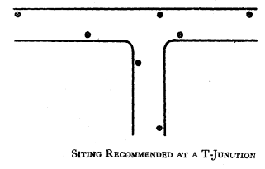
Road lighting
Basic arrangements of road lighting

Slide 21
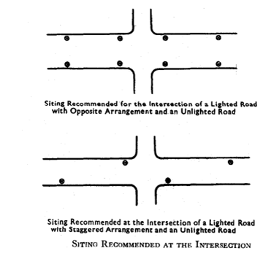
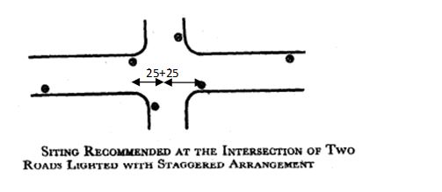
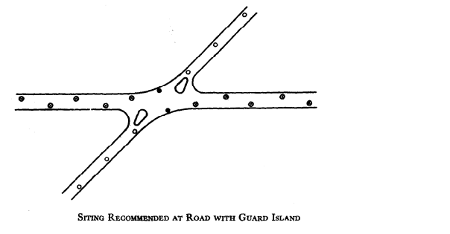
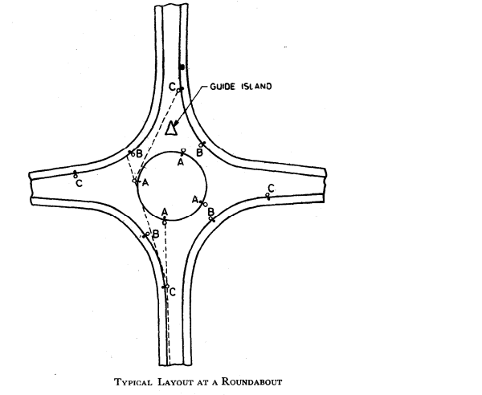
Road lighting
Basic arrangements of road lighting

Slide 22
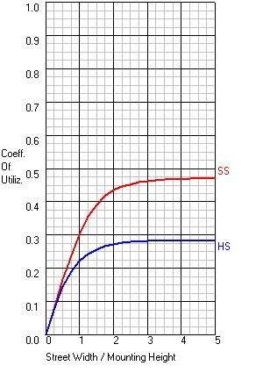
Road lighting
Design of highway lighting systems
Spacing =
Design a street lighting system for the following conditions:
Street width = 15 m
Mounting height = 7.5 m
Lamp size= 6000 lumens
Calculate the spacing between lighting units to produce average lux = 6
Assume maintenance factor = 0.8
From graph for SS, coefficient of utilization for Street Width/Mounting Height= 15/7.5 = 0.44
Spacing = =23.5 m
HS- house lighting; SS if for street lighting

Slide 23
Design factors for highway lighting
Lamps – the various types of lamps in use for highway lighting are filament, fluorescent lamps, sodium or mercury vapour lamps.
Luminaire distribution of light- the distribution of light should be downward so that high percentage of lamp light is utilized for illuminating the pavement and the adjacent areas. The distribution of luminaire should cover the pavement between the kerbs and provide adequate lighting the adjacent areas i.e., 3 m to 5 m beyond the pavement edges. According to Indian Standards Institution, an average level of illumination of 30 lux on important roads carrying fast traffic and 15 lux on main roads, the ratio of minimum to average illumination being 0.4
Spacing of lighting units – large lamps with high mountings and wide spacings would be preferred from economy point of view.
Height and overhang of mounting – usually mounting height range from 6 m to 10 m.
Lateral placement – the street lights should not be too close to the pavement edge. For roads with raised kerbs, the pole should be at a distance of 0.3 m to 0.6 m from the edge of the kerb.
Lighting layouts–this can be either single sided, staggered or central.

Slide 24
Promotion and integration of public transportation, Promotion of non-motorized transport

Slide 25
NMT issues
➢ Define the role of NMT (access only or main mode) in overall mobility of the city (for larger, medium and smaller cities).
➢ Need for change in planning and policy guidelines, to provide seamless travel using NMT.
➢ Development of credible ways to assess the impact of pedestrianization, pedestrian zones, etc.
➢ Ways to integrate hawkers and vendors as part of the pedestrian policy and facility design guidelines.
➢ Providing pedestrian facilities and developing standards for the same.
➢ Effective geometric design for NMT to provide seamlessly connected and safe travel across the city.
➢ Identification of factors that may encourage the use of NMT modes in Indian cities.
➢ Understanding the effect of urban density, mixed landuses, neighbourhood features, etc. on NMT use.
➢ Understanding the potential of traffic calming in pedestrian safety.

Slide 26
Initiatives towards promoting Non-motorized transport
NMT i.e. walk, cycle and cycle rickshaw are green modes of transport that belong to the low carbon path, do not consume energy or cause pollution, provide social equity and in addition provides employment.
1. National Urban Renewal Mission (NURM) of Central Government would give priority to the construction of cycle tracks and pedestrian paths in all cities.
2. Formulation and implementation of specific “Area Plans” in congested urban areas that propose appropriate mix of various modes of transport including exclusive zones for NMT.
3. Central Government Initiatives like Atal Mission for Rejuvenation and Urban Transformation –AMRUT, Smart Cities Mission
4. Construction of segregated rights of way for walk and cycles.
5. Segregation of vehicles moving at different speeds would enable full trips using NMT but also as a means of improving access to Public Transport stations.
6. Creative facilities like shade giving landscaping, provision of drinking water and resting stations along bicycle corridors
7. The use of the central verge along many roads, along with innovatively designed road crossings.
8. Pedestrian and cycle facilities including crossing facilities at busy intersections should be well-maintained and kept free of encroachments.

Slide 27
Public transport issues
➢ Need for systems approach in public transportation planning (address O-D travel time effectively, include all modes).
➢ Inter-modal integration – operational, physical, institutional, still to be effectively developed and achieved in India.
➢ Need to develop integrated approach for corridor identification (for Metro, BRTS, etc.) in metropolitan cities.
➢ Better transit ridership estimates – to enhance our understanding of existing and potential transit users, their behaviour, attitudes and opinions.
➢ To evolve passenger information system design (especially for pre-trip planning) that is suitable for Indian cities (particularly due to weak inter-modal integration, differential importance assigned by users to different legs of the trip, etc.).
➢ Route and schedule rationalization.
➢ Better understanding of requirements from optimality in routing and scheduling, i.e. what is required for a transit agency – global optimum, local optimum or set of pareto-optimal solutions?
➢ Better comfort and convenience to the public transport passengers.

Slide 28
Initiatives towards promoting Public Transport
Public Transport consists of mass rapid transit (MRT); Para-transit and personalized PT. MRT, both rail and road based and including city bus is the backbone of city transport as they are the only modes that carry very large number of people using minimum space. Paratransit Modes i.e. tempos and mini buses supplement MRT in large cities and can be the main mode of PT in medium and small size cities.
1. Integrating land use and transport planning: Provide 50% of the cost of preparing comprehensive city transport plans and detailed project reports and reduce travel demand by better integration of land-use and transport planning.
2. Development of Suburban rail and metro systems. Cities like Delhi, Mumbai, Chennai, Kolkata, Bangalore, and Hyderabad have all been either expanding or improving their rail systems.
3. Privatization of bus services. Compared to the publicly owned, operated, and subsidized bus services in the same cities, the privately run services have higher productivity, lower costs, more passengers per bus, and higher revenues per bus km of service.

Slide 29
Initiatives towards promoting Public Transport
4. Improve motor vehicle technology and fuels. The most successful measure was the complete phasing out of lead in fuels. The allowable levels of sulphur and benzene in fuels were also reduced. Expert commission of the Indian Government has recommended successively adopting the increasingly stringent Euro II, Euro III, and Euro IV emission standards for all new cars, taxis, trucks, and buses, first in the largest cities and then for the entire country (Ministry of Petroleum and Natural Gas, 2002).
5. Jawaharlal Nehru National Urban Renewal Mission (JnNURM) is a reform-based mission with due emphasis on urban transport. This mission emphasies on the commuter comfort while traveling in public transport at reasonable cost.
6. Better cooperation among different transport agencies, departments, and ministries as well as better overall coordination of transport and land-use policies.
7. Central Government Initiatives like Atal Mission for Rejuvenation and Urban Transformation –AMRUT, Smart Cities Mission emphasises on increasing the amenity value of cities by switching on to public transport or constructing facilities for non-motorized transport e.g. walking and cycling.

